Slide 1
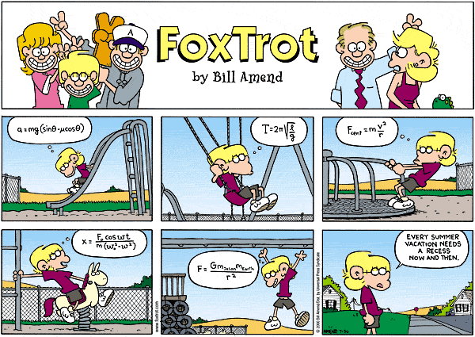
Introduction to Motion: Terminology, Vectors and Scalars!

Slide 2
Scalar Quantities
Scalar quantities consist of a number (called the magnitude) and a unit
Examples:
25 days (time) 15 m (length/distance)
32 m/s (speed)
186 m² (area) 214 m³ (volume)

Slide 3
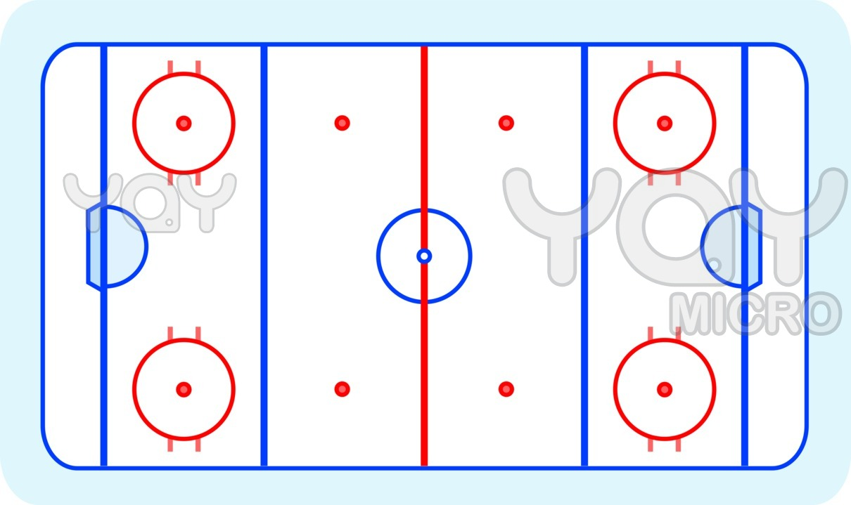
On the field below, both players are a distance (d) of 50 ft from the centre. How can we differentiate between their locations?
50 ft
50 ft
Notes:
This introduces the idea of NEEDING A DIRECTION! (Vector Quantities)

Slide 4
Vector Quantities
Vector quantities consist of a number, a unit, and a direction.
Tail
Tip
Length = Magnitude
50 ft
50 ft

Slide 5
Vector vs. Scalar
Indicate whether or not each of the following is a vector (V) or a scalar (S):
50 km/h, Scalar
6 km/h [N], Vector
200 kg / m³ , Scalar
12 centuries, Scalar
25 m/s [S 45º W], Vector
Notes:
Ans: a) S b) V c) S d) S e) V

Slide 6
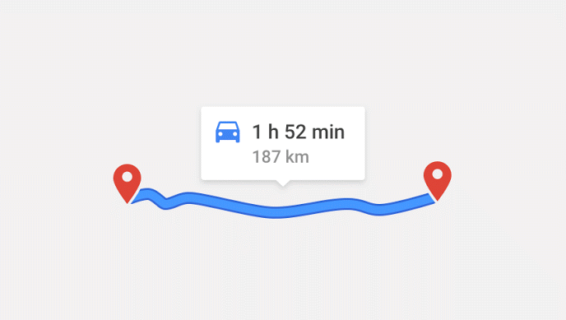
Distance (Scalar)
Space between an object and a point
OR
Total length of the path travelled by an object

Slide 7




Position (Vector)
Position ($\vec{d}$): the location of an object RELATIVE to a specified point
3 m [W]
5 m [E]
11 m [E]
Includes a distance, unit, and direction
Notes:
Can also think of it as: Position is the distance and direction of an object from a specific point

Slide 8
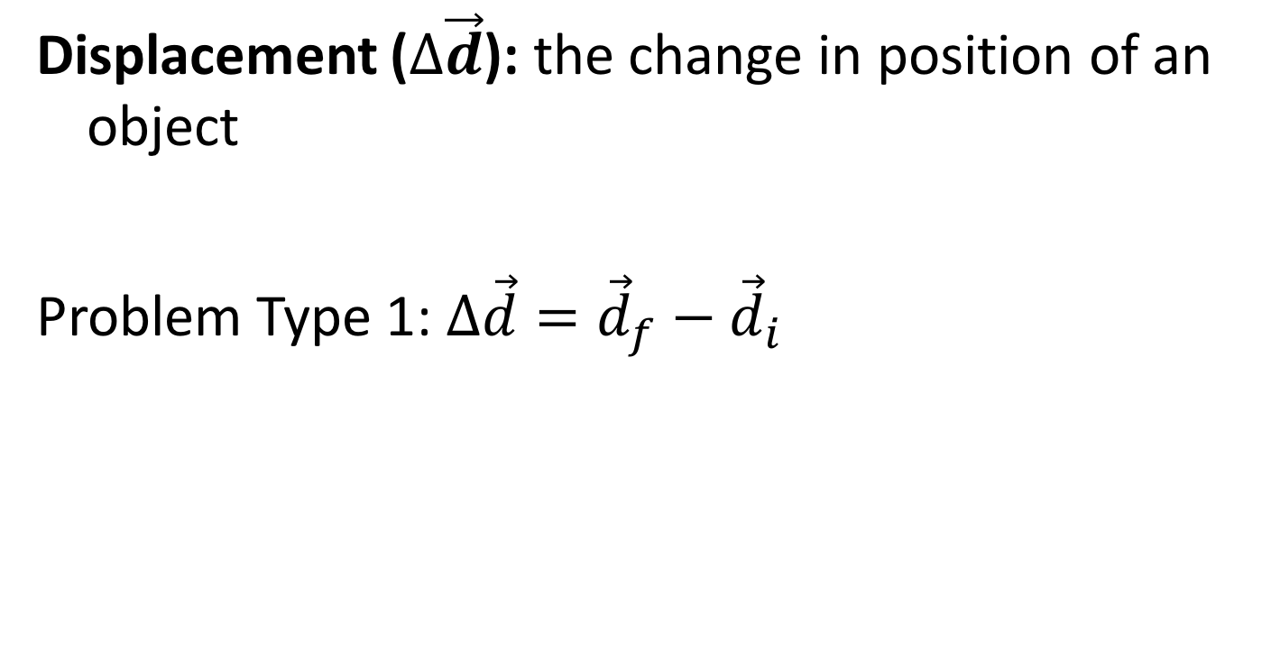
Displacement (Vector)
Displacement ($∆\vec{d}$): the change in position of an object
Problem Type 1: $∆\vec{d}={\vec{d}}_{f}−{\vec{d}}_{i}$
End:
3 m [W]
Start:
5 m [E]
Notes:
Watch your signs! You cannot add/subtract the magnitudes if the directions are different!
*this is an example of 1D motion. We must be careful when doing this type of problem because the directions are not the same (therefore they are not yet “like terms”)
Ans: 8 m [W]

Slide 9



Displacement – continued…
A common term for total displacement is resultant (or net) displacement
Displacement ($∆\vec{d}$):
Problem Type 2: $∆\vec{d}={\vec{d}}_{1}+{\vec{d}}_{2}+…$
End:
3 m [W]
Then:
5 m [E]
Start:
0 m [E]
$${\vec{d}}_{2}=8m[W]$$
$${\vec{d}}_{1}=5m[E]$$
Notes:
Watch your signs! You cannot add/subtract the magnitudes if the directions are different!
Again, this is 1D motion.
Ans: 3 m [W]

Slide 10
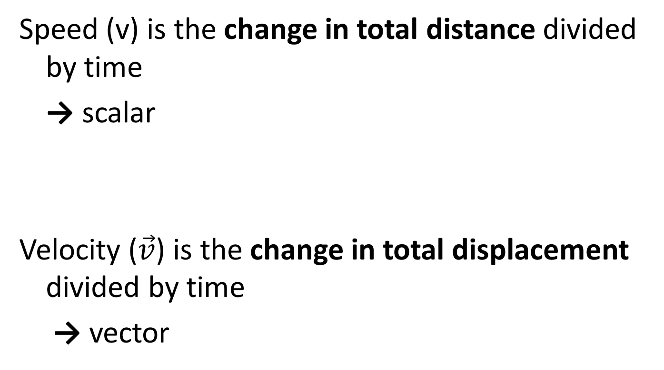

Speed and Velocity
Speed (v) is the change in total distance divided by time
→ scalar
Velocity ($\vec{v}$) is the change in total displacement divided by time
→ vector
$$\vec{v}=\frac{∆\vec{d}}{∆t}$$

Slide 11
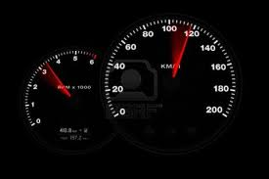

Acceleration (Vector)
Acceleration is the change in velocity divided by time
$$\vec{a}=\frac{∆\vec{v}}{∆t}$$

Slide 12
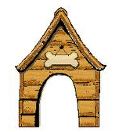


Example
Determine the distance, displacement, speed, and velocity of the dog.
t = 9.0 s
A
B
16 m
12 m
D
C
Notes:
Distance = 16 m
Displacement = 16 m [E]
Speed = 1.7 m/s
Velocity = 1.7 m/s [E]

Slide 13
Example
Determine the distance, displacement, speed, and velocity of the dog.
t = 24.0 s
A
B
16 m
12 m
D
C
Notes:
This is an example of 2D motion which is more difficult
Distance = 44 m
Displacement = 12 m [S]
Speed = 1.8 m/s
Velocity = 0.50 m/s [S]

Slide 14
Example
Determine the distance, displacement, speed, and velocity of the dog.
t = 30.0 s
A
B
16 m
12 m
D
C
Notes:
Distance = 56 m
Displacement = 0 m [E]
Speed = 1.9 m/s
Velocity = 0 m/s [E]

Slide 15
Extend Your Thinking
What would the displacement be for the following?
A
B
16 m
12 m
D
C
Notes:
20 m [E 37ºS]

